Slide 1
ENSE 470 - Milestone 2
Group Name: GLHF
Group Members:
Vincent Chan
Thiago De Melo
Shuaihao Zhao
Joe Emmanuel Samano
January 25, 2018

Slide 2
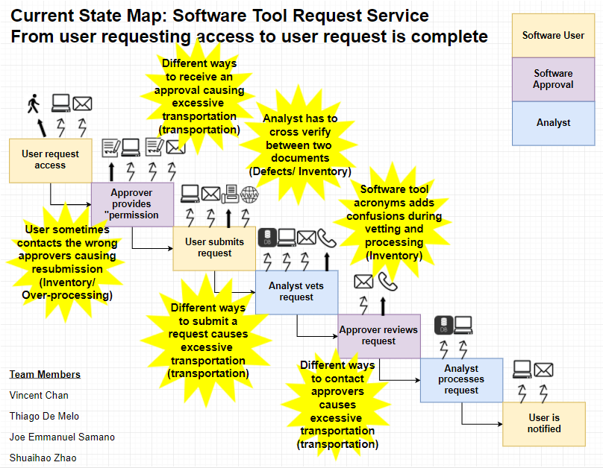

Slide 3
Theme 1: Too many options

Slide 4
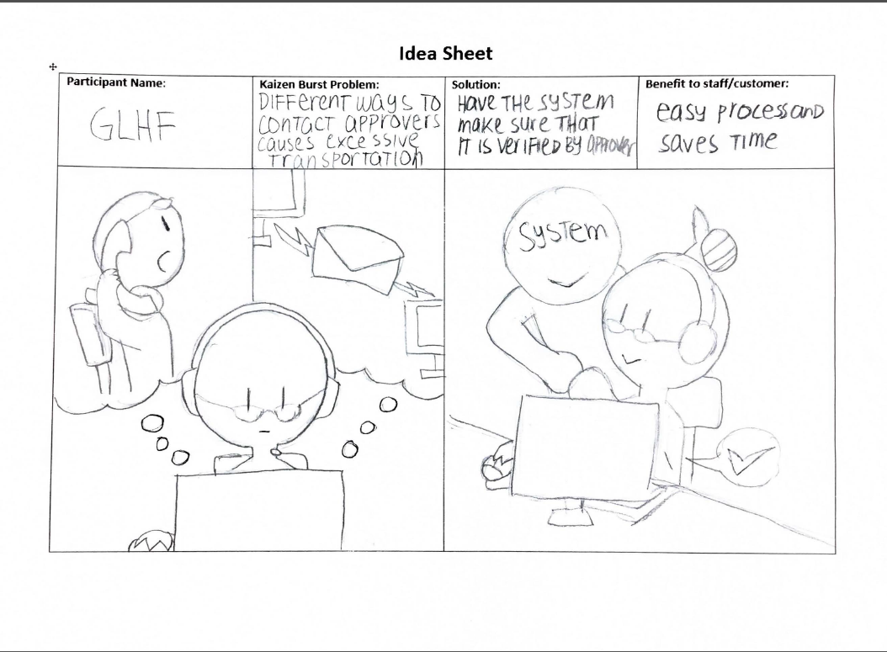

Slide 5
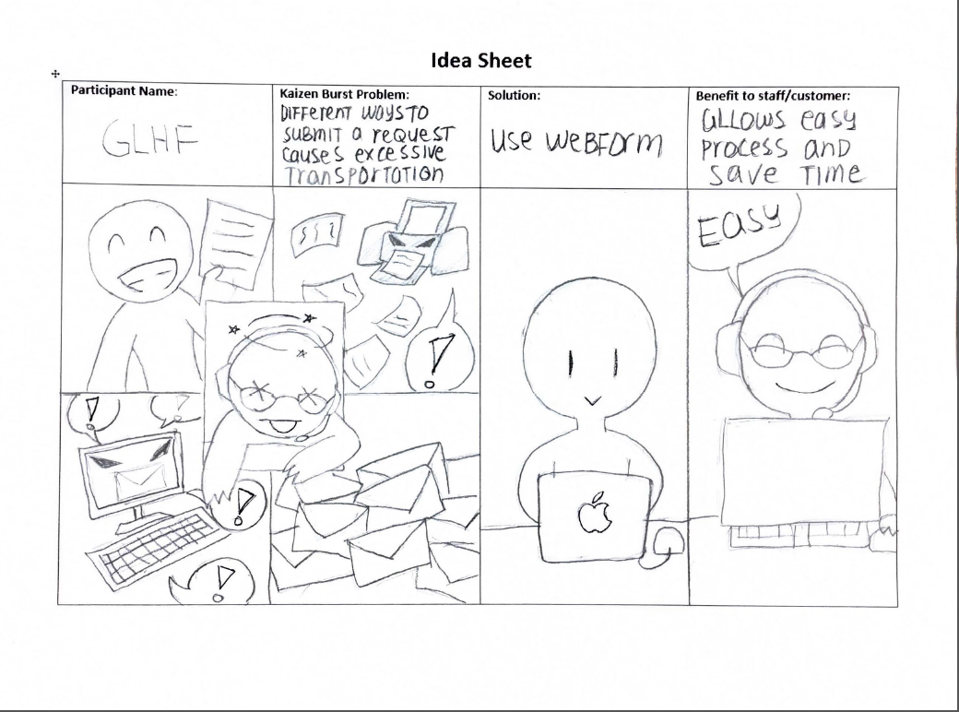

Slide 6
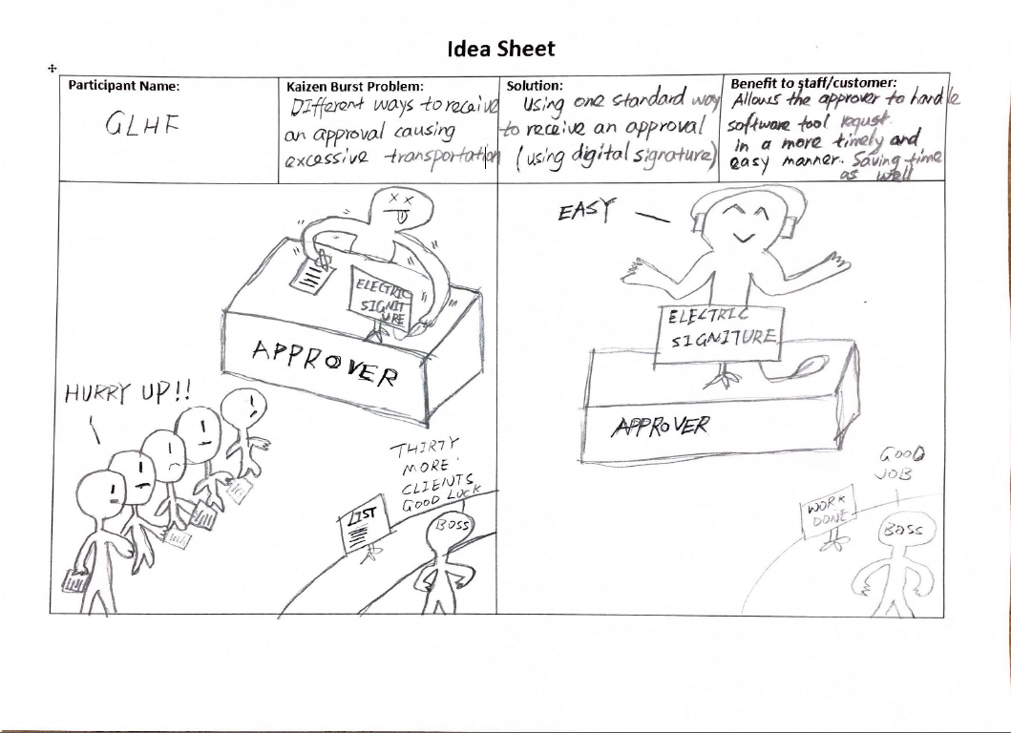

Slide 7
Theme 2: Unified System

Slide 8
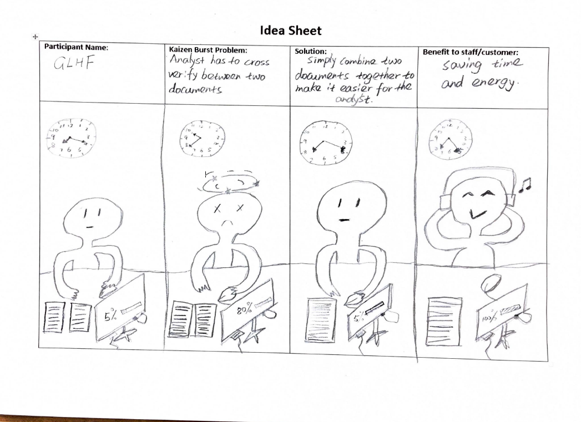

Slide 9
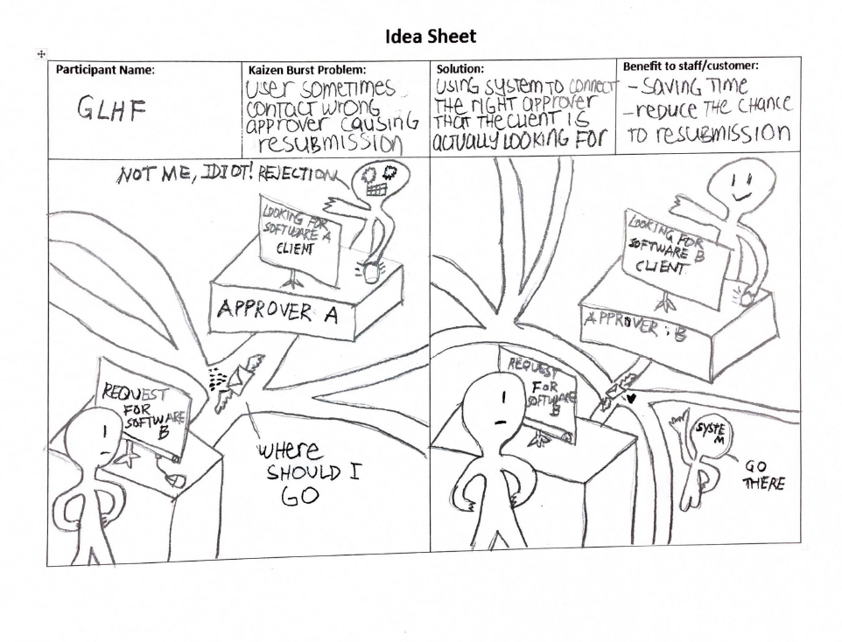

Slide 10
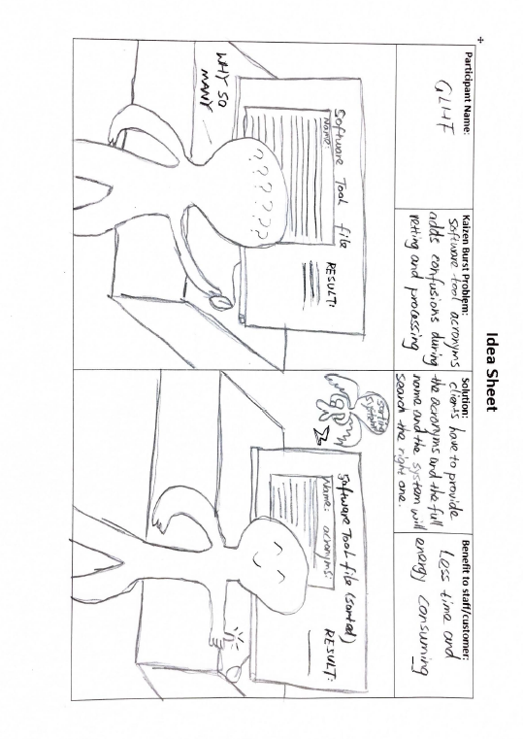

Slide 11
Future VSM

Slide 12
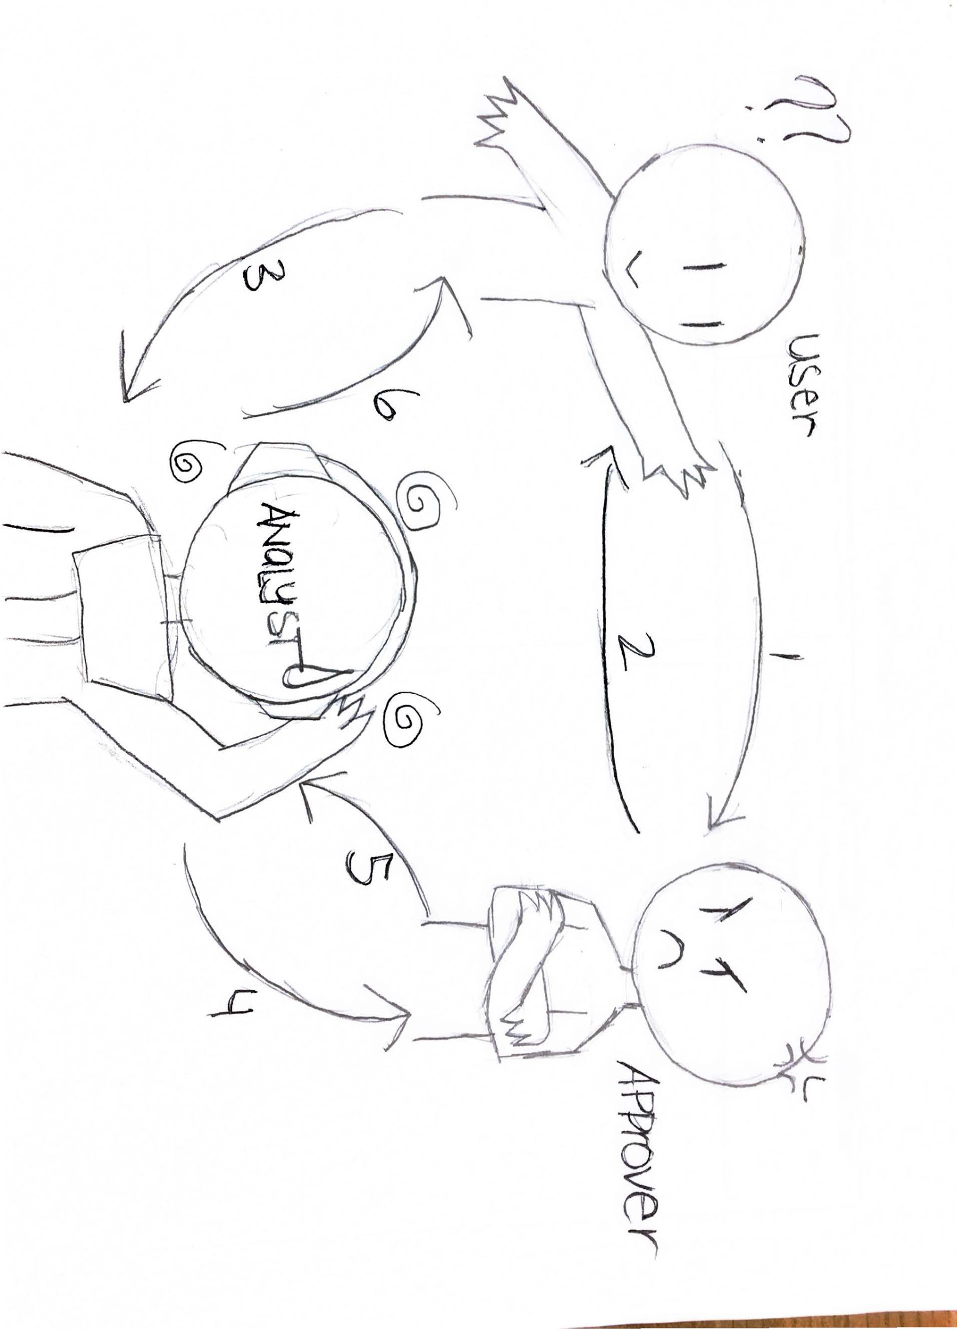
Current VSM Process flow

Slide 13
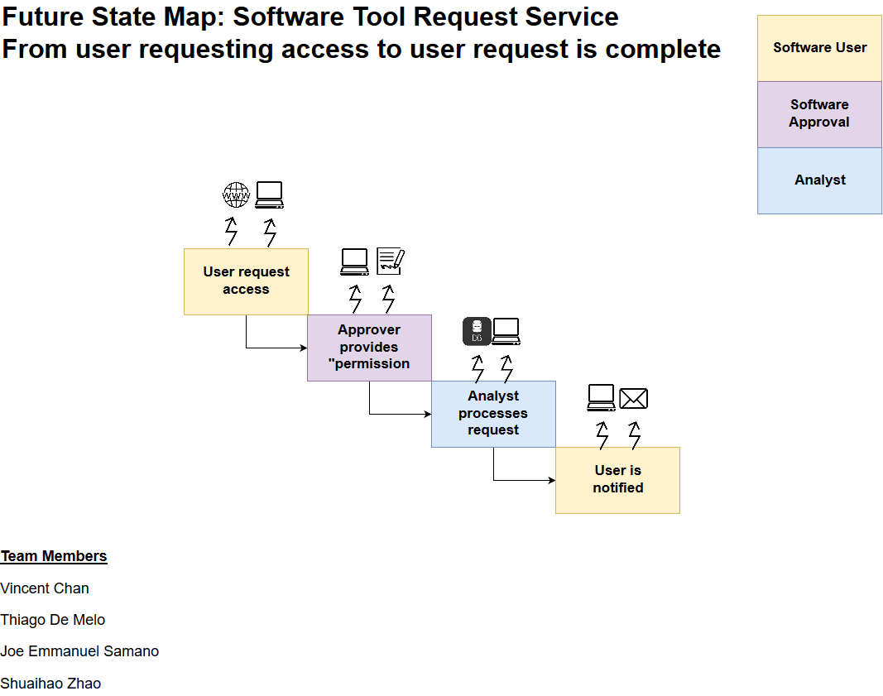
Wrong Approver: Waste Eliminated - User wait time - Over-processing - Unneeded Movement
Different Approval Types: Waste Eliminated - Signature inventory - Over-processing - Signature transportation
Different Approver Files: Waste Eliminated
Defects
Over-processing
File Inventory
Confusing Acronyms: Waste Eliminated
- Defects - Over-processing
Different Submission Types: Waste Eliminated - Submission transportation - Over-processing
Different Means of contact: Waste Eliminated
- Analyst Waiting - Over-processing

Slide 14
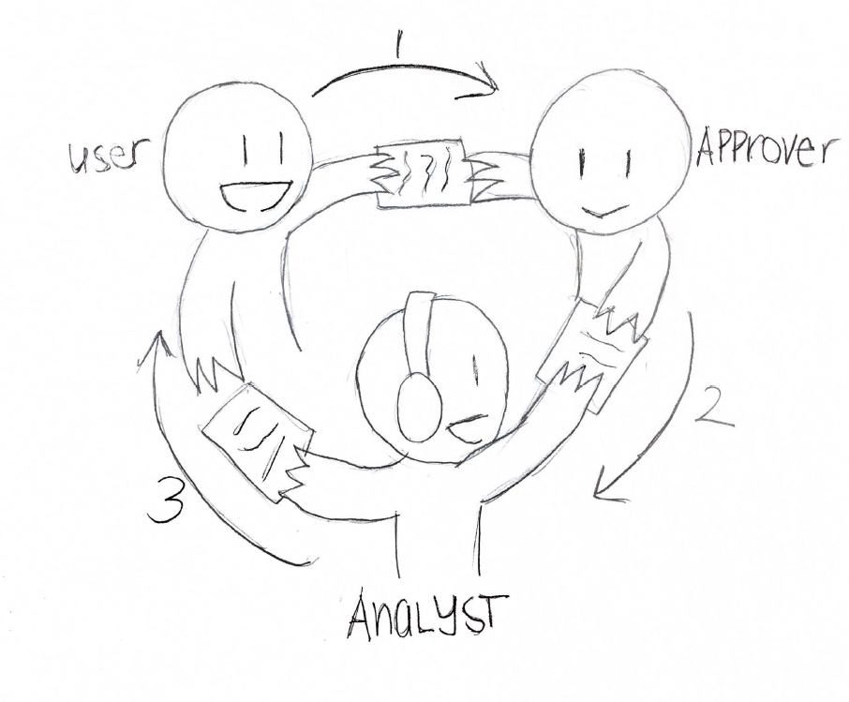
Future VSM Process flow

Slide 15
Group Reflection
How did you feel about this milestone? What did you like about it? What did you dislike?
Difficult getting started.
Helps with visualizing the solutions to the Kaizen problems.
Updating the Future VSM with respect the idea sheets
What did you learn about yourself as you collaborated and worked through this milestone?
Everyone has different ideas for solutions. Solutions were chosen based on a group consensus. Group members has different insights which helps guide us to our FSM
How will you use what you have learned going forward?
We can use this to make improvements to an existing process
Can use to to help visual the whole process and to develop the software solution
What “stuff & things” related to this milestone would you want help with?
Unsure whether an idea sheet for one kaizen burst solves another kaizen bursts as well.

